Slide 1

EN2130 Communication Design Project
Semester 3

Slide 2
Learning outcomes
Identify the requirements and limitations of a basic communication system.
Differentiate between different network architectures, topologies, and technologies.
Select a suitable communication technology to cater to a given simple application.
Select necessary components to build a simple communication system (wired/wireless) to solve a given problem.
Realize a simple communication system to enable successful end-to-end connectivity.

Slide 3
Content
Elements of a communication system, reliability objectives, Error detection and correction coding, line coding, synchronization, simple digital modulation and demodulation methods, channels
Review of networks, layered architecture, protocols, and standards.
Hardware components of a transmitter, receiver, chipsets, off-the-shelf components, antennas, interfaces and their usage, connectors, software defined radios.
Link budgets, setting transmitter/receiver parameters, selecting a suitable technology
Introduction to simulation tools, simulation of simple networks, performance evaluation and obtaining insights, measurements and measuring equipment.

Slide 4
People
Instructors
Kasun Hemachandra – kasunh@uom.lk
Tharaka Samarasinghe – tharakas@uom.lk
Teaching Assistant
Lathika Wathsara
Christ Clenson
Office hours
Wednesday 1.15 PM – 2.45 PM
In-class/in-lab questions are the most preferred method of contact

Slide 5
Assessments
Item | Distribute | Deadline | Weight
Labs – 6 Nos | - | - | 20%
Project | July 29th | Semester end | 50%
Written exam | TBD | TBD | 30%

Slide 6
Working hours
Lectures
Wednesday – 9.15 AM – 10.15 AM
Lab sessions
Tuesday – 3.15 PM – 5.15 PM
Wednesday – 10.15 AM – 12.15 PM
Telecom lab will be assigned for project work

Slide 7
Textbooks
Modern Analog and Digital Communication Systems, by B. P. Lathi and Z. Ding, 5th Edition, Oxford University Press, 2018
Software Receiver Design: Build Your Own Digital Communication System in Five Easy Steps, by Richard Johnson Jr., William A. Sethares & Andrew G. Klein
Software Defined Radio Using MATLAB & Simulink and RTL - SDR

Slide 8
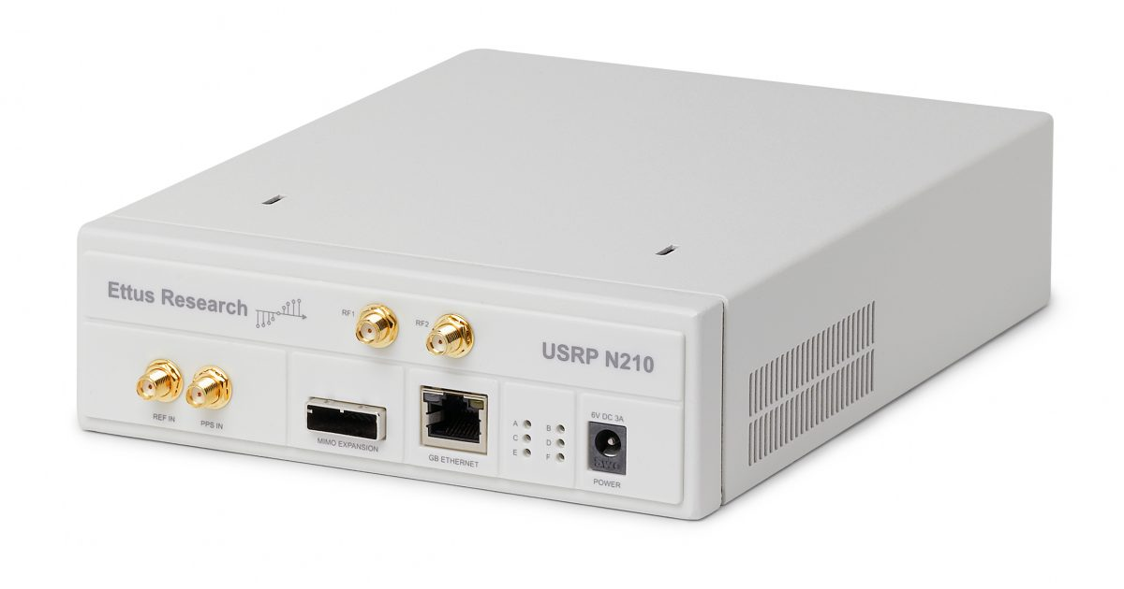
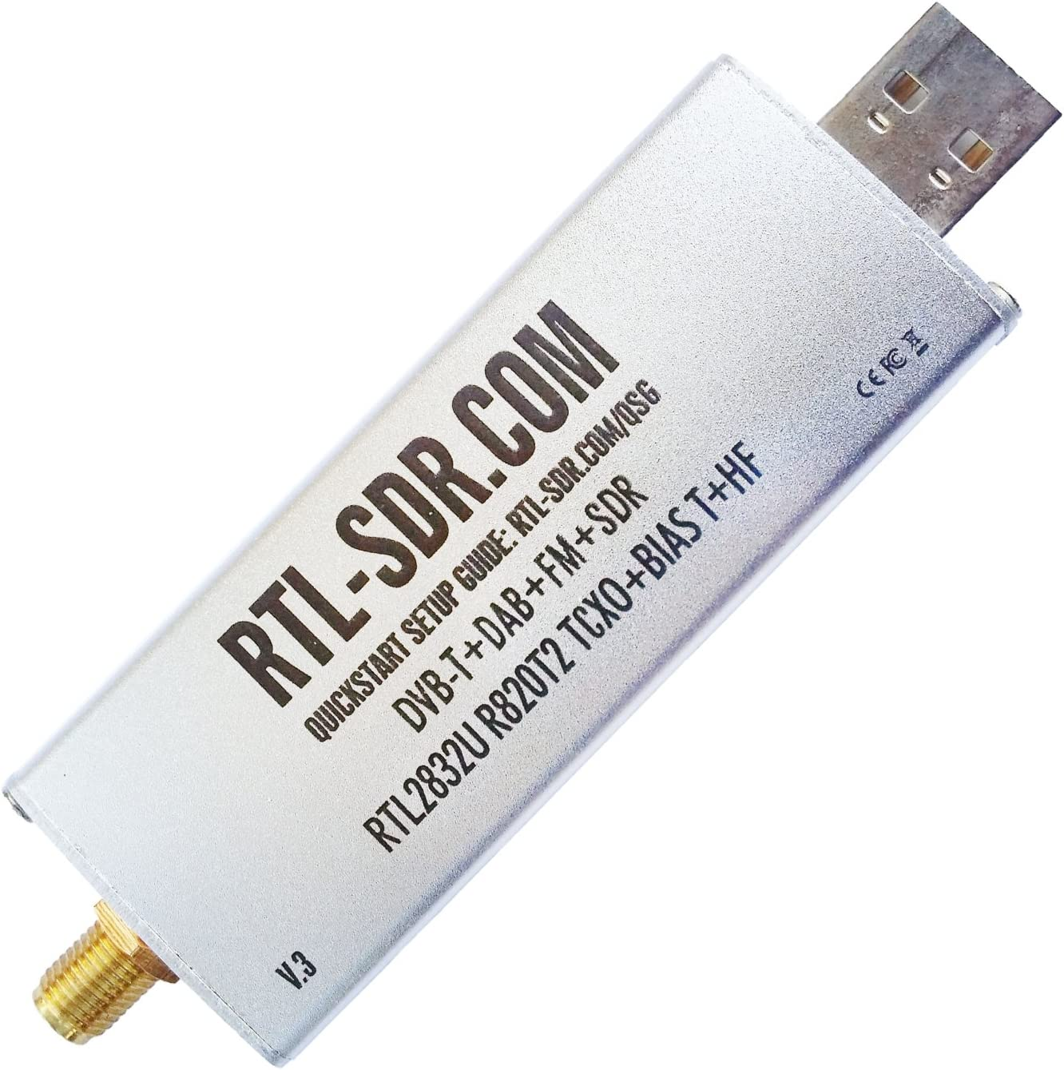
Hardware and Software
Software defined radio units
Ettus Research USRP – N210
NI USRP – 2922
BLADERF 2.0 MICRO XA9
Software defined radio units (receive only)
RTL-SDR
GNU Radio, MATLAB

Slide 9
Cool stuff to be made
https://www.youtube.com/watch?v=GtJx_pZjvzc
Audio transmission and reception
Image transmission and reception
Handling channel imperfections
You can build your own application

